Slide 1
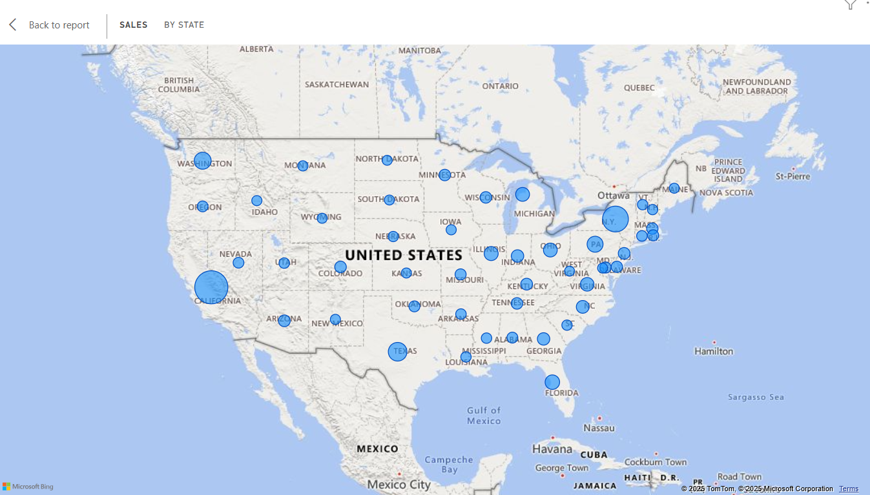
Superstore Sales Analysis
From the report we can see that highest sales were done in California and then New York.

Slide 2
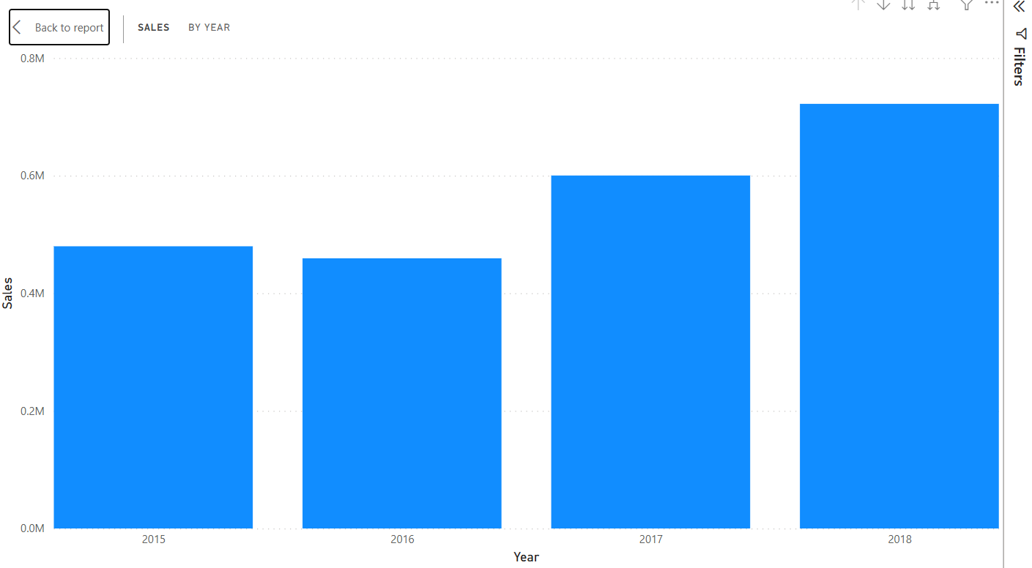
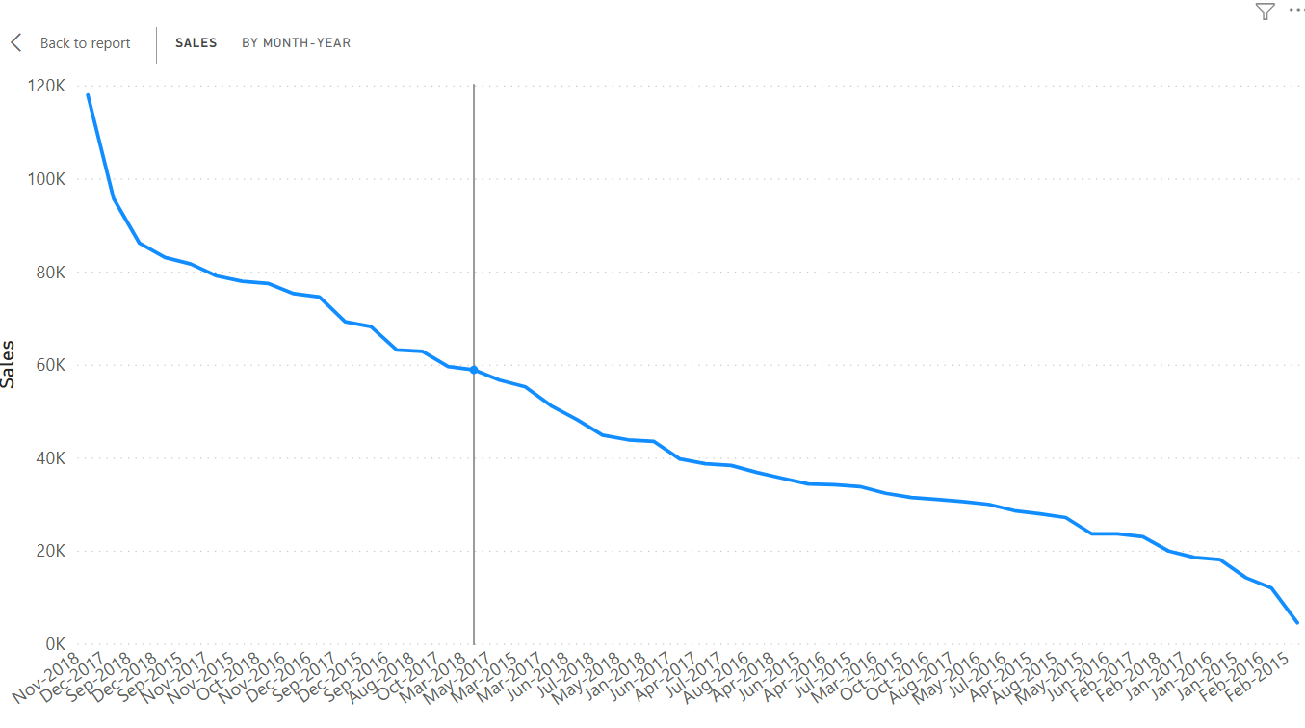
Yearwise 2018 has highest number of sales
Monthwise-Yearwise Nov 2018 has done highest number of sales.

Slide 3
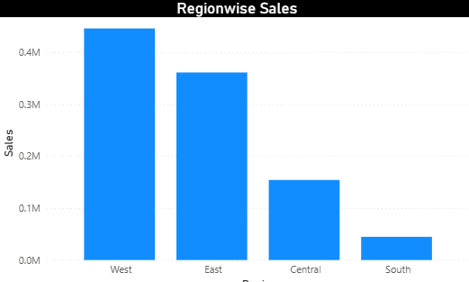
West Region has highest number of sales.

